Slide 1
React.js course

Slide 2
ES6+ and React crash course
Day one

Slide 3
JS

Slide 4
Data types
Basic types:
String
Boolean
Number
Null
Undefined
BigInt
Symbol
Complex types:
Objects
functions

Slide 5
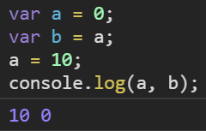
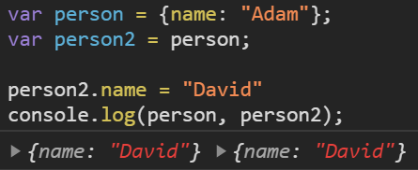
Difference between primitive and complex types
Basic values are passed by value
Complex types passed by reference (both person and person2 are pointing to the same object)

Slide 6
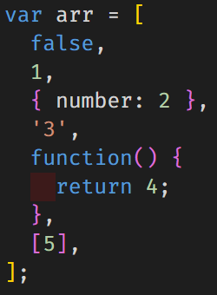
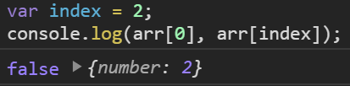
Array
List of values
Represented by index (starting from 0)
Any type of data can be stores in an array, including other arrays
Values can be accessed using square bracket notation, also using dynamic values

Slide 7
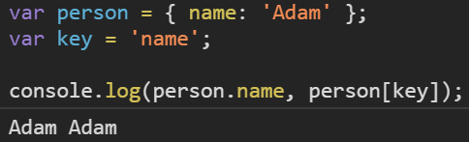
Object
Values represented by a key-value pair
Same as for arrays, values can have any type
Keys have to be a string
Values can be accessed by either dot or square bracket notation (dynamic access possible only with the square bracket notation)

Slide 8
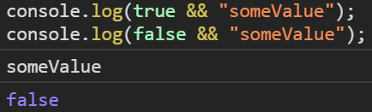
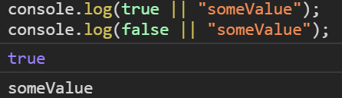
Conditional statements
a && b – AND operator
a || b – OR operator
condition ? a : b – ternary operator (shortcut if/else)

Slide 9
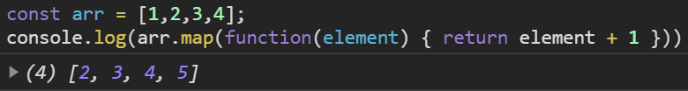
Array methods
Array.prototype.map – return an array of modified elements
Array.prototype.filter – return an array of elements that fulfill a requirement
Array.prototype.find – returns the first element that fulfills a requirement
… and many others

Slide 10
ES6 and beyond

Slide 11
ES6 - introduction
ES6 (ECMAScript 2015) - new syntax allowing to do more by writing less
Biggest update to the language so far
Its knowledge is essential to work with modern JS frameworks
Some browsers still don't support it fully, thus requiring us to use JavaScript compilers
https://github.com/ppuzio/react-course-examples/tree/master/es6-examples

Slide 12
ES6 essentials
let and const instead of var
arrow functions
promise as a way of handling asynchronous operations
destructuring
spread/rest operators
template literals
default values
Classes
modules
and many, many more...

Slide 13
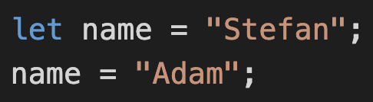
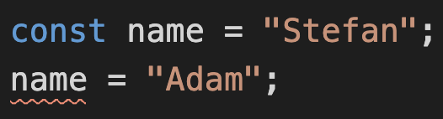
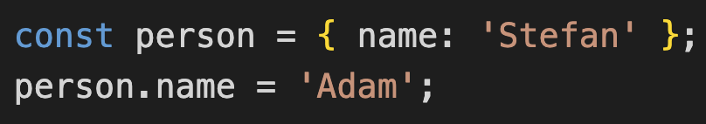
Declaring and reassigning data
var replaced by let and const
let – think of it as „let age be equal to 15” – variables which can have their reference changed
const – short for constant – variables with a constant reference to a value
this does not make variables immutable!

Slide 14
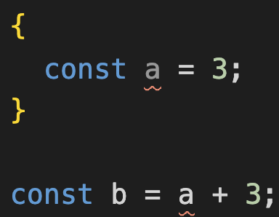

Declaring and reassigning data
Variables declared with let and const:
are block scoped – scope is limited within curly braces
cannot be redeclared

Slide 15
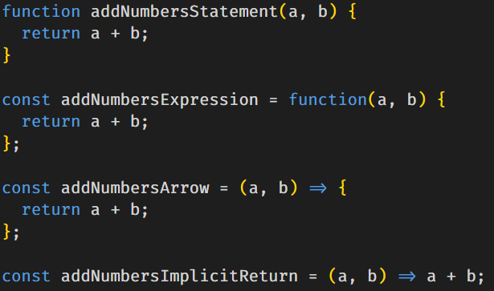
Arrow functions – shorthand way of writing functions
Previously the only way to create a function was to either create a function statement or function expression
Arrow functions offer a shorter syntax which also allows to implicitly return a value without the necessity to use curly braces and return keyword

Slide 16
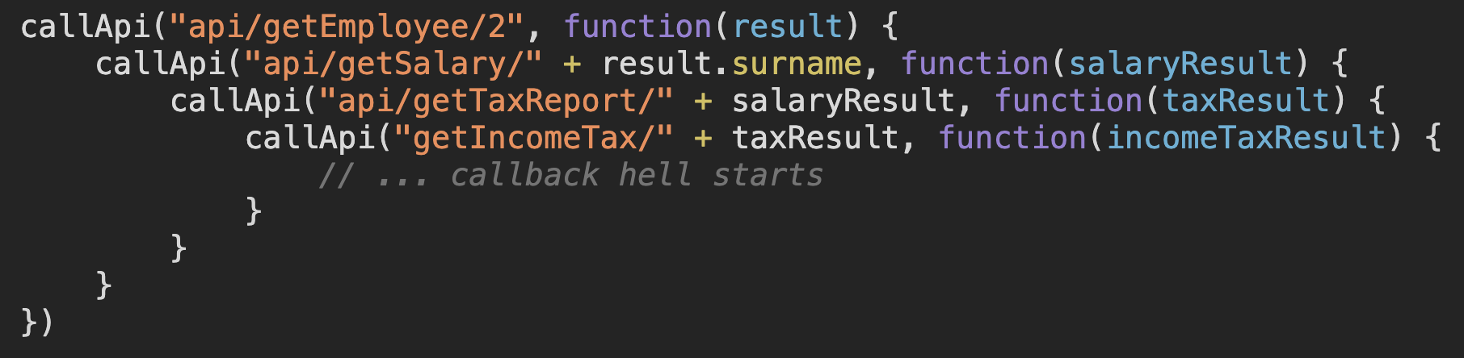
Promises – an elegant way of handling asynchronicity
Previously, the only way to "synchronize" asynchronity was by using callbacks
This wasn't the most readable method (famous callback hell) and caused lots of bugs. Since asynchronity is a very confusing subject in JavaScript, the issue had to be adressed
Notes:
callApi("api/getEmployee/2", function(result) {
callApi("api/getSalary/" + result.surname, function(salaryResult) {
callApi("api/getTaxReport/" + salaryResult, function(taxResult) {
callApi("getIncomeTax/" + taxResult, function(incomeTaxResult) {
// ... callback hell starts
}
}
}
})

Slide 17
Promises – an elegant way of handling asynchronicity
So why should you be excited about promises?
Instead of passing callbacks, we attach them along the way
A promise can be in one of three states: pending, resolved or rejected
A pending promise is still processing the internal call and will eventually transition to either of the latter states
A resolved promise is one that returns a value, whatever it might be
A rejected promise is a result of a failed action. This status allows us to handle errors
Useful helpers in the Promise.prototype:
Promise.prototype.all() - return a promise when all passed promises have been resolved
Promise.prototype.race() - return the first promise that is resolved or rejects
Promise.prototype.allSettled() - return an array of statuses (fulfilled/rejected)

Slide 18
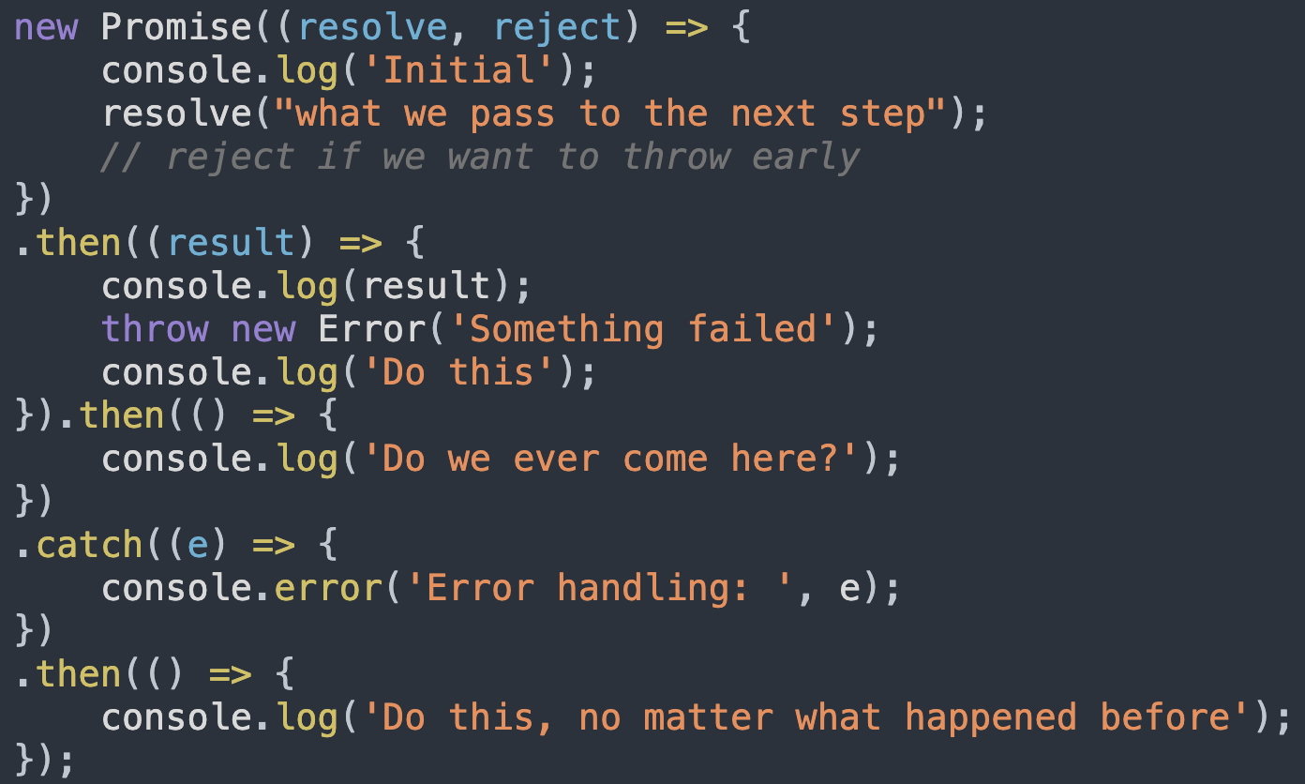
Promises – an elegant way of handling asynchronicity
Promises have a straightforward syntax
A promise function has two arguments:
Function used to return a value to the next step,
Function used to throw an error early
The then keyword allows us to declare the behavior for the next step
The catch keyword makes sure we can have a universal error handling method which will work regardless of which step would result in an error
The finally keyword allows us to declare some behavior that occurs at the end, regardless of whether the promise was resolved or rejected
Notes:
new Promise((resolve, reject) => {
console.log('Initial');
resolve("what we pass to the next step");
// reject() // if we want to throw early
})
.then((result) => {
console.log(result);
throw new Error('Something failed');
console.log('Do this');
}).then(() => {
console.log('Do we ever come here?');
})
.catch((e) => {
console.error('Error handling: ', e);
})
.then(() => {
console.log('Do this, no matter what happened before');
});

Slide 19
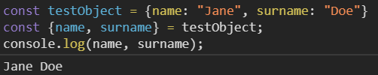
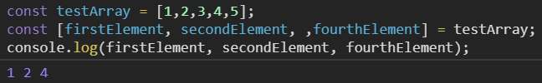
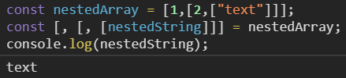
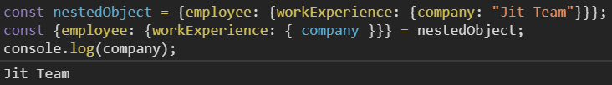
Destructuring
Destructuring allows us to assign parts of arrays or objects to new variables and aliasing them (for objects)
Accessing deeply nested properties/elements is especially easy when using destructuring
Notes:
const testArray = [1,2,3,4,5];
const [firstElement, secondElement, ,fourthElement] = testArray;
console.log(firstElement, secondElement, fourthElement);
const testObject = {name: "Jane", surname: "Doe"}
const {name, surname} = testObject;
console.log(name, surname);
const nestedObject = {employee: {workExperience: {company: "Jit Team"}}};
const {employee: {workExperience: { company }}} = nestedObject;
console.log(company);
const nestedArray = [1,[2,["text"]]];
const [, [, [nestedString]]] = nestedArray;
console.log(nestedString);

Slide 20
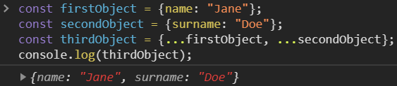
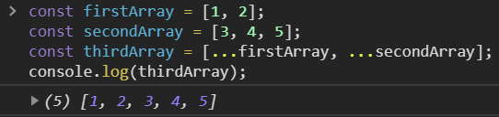


Spread/rest operator
Spread - expand an object (ES9) or an array
Rest - collect all remaining elements into an object or an array
Notes:
const firstArray = [1, 2];
const secondArray = [3, 4, 5];
const thirdArray = [...firstArray, ...secondArray];
console.log(thirdArray); const firstObject = {name: "Jane"};
const secondObject = {surname: "Doe"};
const thirdObject = {...firstObject, ...secondObject};
console.log(thirdObject);
const [firstElement, secondElement, , fourthElement] = thirdArray;
console.log(firstElement, secondElement, fourthElement);
const { name, ...rest } = thirdObject;
console.log(rest);

Slide 21
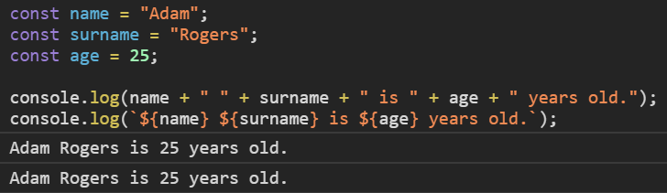
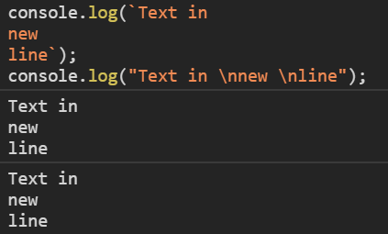
Template literals
Syntax allowing to embed JavaScript expressions
Instead of double ("") or single quoation marks ('') text is enclosed using back-ticks (``)
Variables have to be surrounded by ${}
Allows multi-line strings and string interpolation

Slide 22
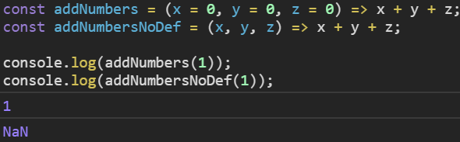
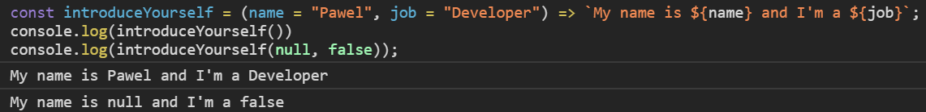
Default values
This functionality allows adding default values for function parameters
Keep in mind this only protects us from lack of value/undefined being passed as an argument – other falsy values will not behave accordingly

Slide 23
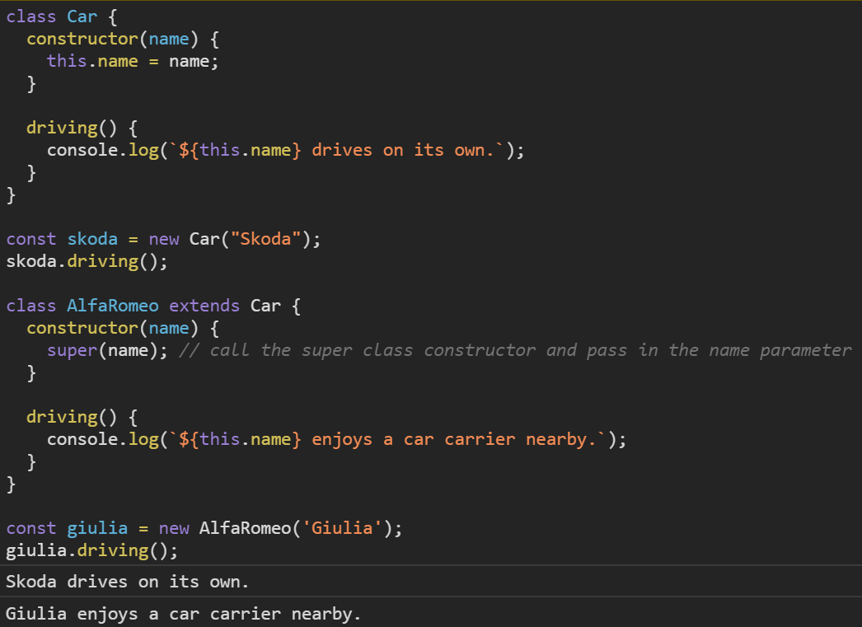
Classes
Syntatical sugar over JS's prototype-based inheritance
Does NOT introduce an OO inheritance model
Allows static methods, getters, setters, etc.

Slide 24
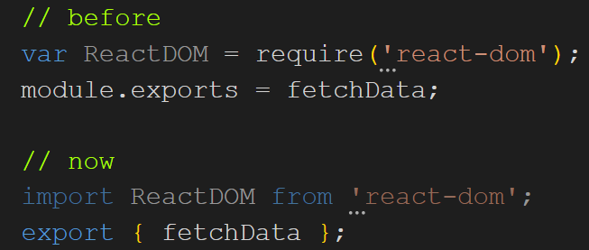
Modules
A new way of importing / exporting
Allows us to declare default exports – we don’t need to know the name of a member to import it
We can also alias members using the as keyword
https://codesandbox.io/s/jovial-architecture-qug6t

Slide 25
ES6+ essentials
async/await - another approach to asynchronity
Object.values() and Object.entries()
Generators
https://github.com/ppuzio/react-course-examples/tree/master/es6%2B

Slide 26
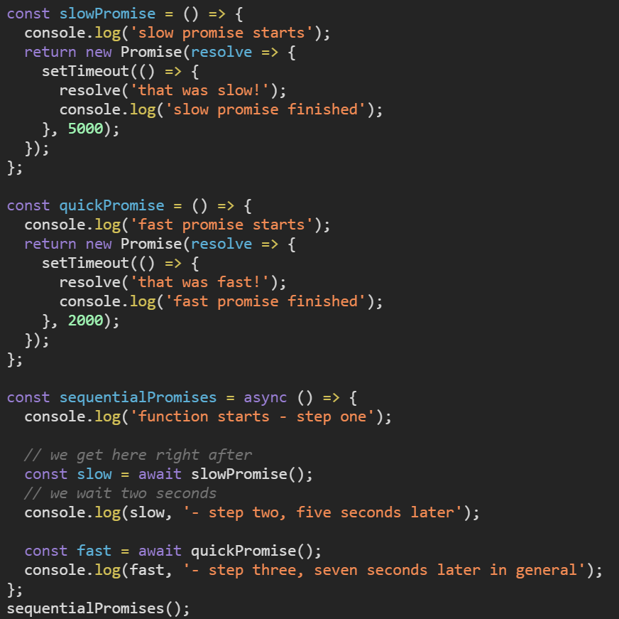
async/await
Allows to declare an asynchronous function – returning a Promise as a result
Code has a very similar syntax to standard synchronous functions
Combines the behavior of generators and promises

Slide 27
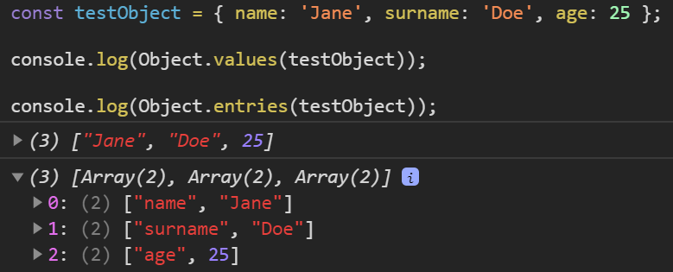
Object.values()/Object.entries()
Two methods allowing us to:
Object.values() - receive an array of values of all properties
Object.entries() - receive an array of [key, value] pairs of all properties

Slide 28
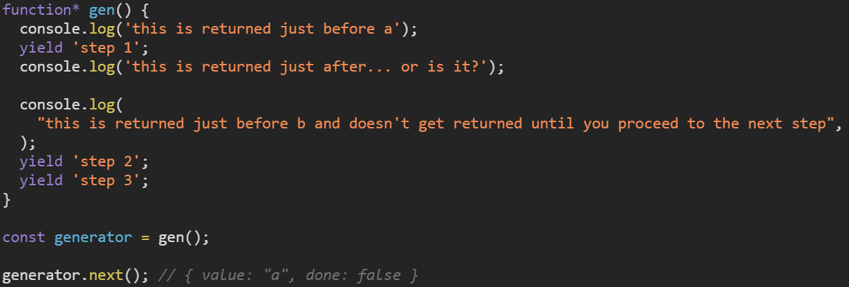
Generators
Functionality based on iterators, their execution is not continuous – we can choose when to execute the next step
Generator functions are always followed by an asterisk
Rarely used, although some codebases can feature them (e.g. ones using Redux-saga)
Returns an object consisting of value yielded in the current step and a flag which specifies if all arguments have been yielded

Slide 29
React.js

Slide 30
React
Debuted on Facebook's Newsfeed in 2011, first public release in 2013
UI library – not a framework
Focuses on creating UI components that can be reused and show data that changes over time
Most apps make use of JSX – optiomal syntax extension which combines JavaScript with HTML
4th most starred repository on github.com (Jan 2020), used by over 2.9M repositories
Lightweight approach to updating DOM nodes called reconciliation – more in the next slides

Slide 31

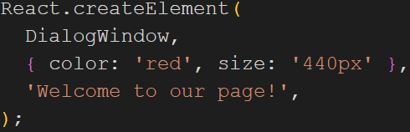
JSX
Syntatic sugar for React.createElement(component, props, ...children) function
We capitalize the tag so that React knows we're referring to a component, instead it will consider it an HTML tag
React must always be imported when using JSX

Slide 32
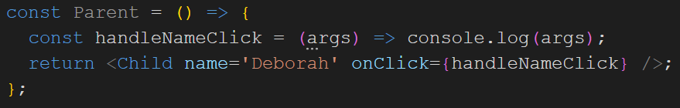
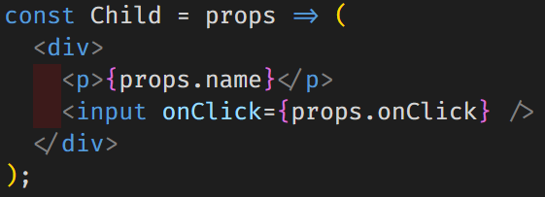
Unidirectional data flow
In React, to pass data down, we use props
Components cannot directly modify properties
To pass data up, we use events, which can modify the properties which we pass down later
Change of props result in a rerender

Slide 33
Virtual DOM (ReactDom)
Virtual representation of DOM is kept in memory and synchronized with the actual DOM
We tell React what we want the state of UI to be – no need for attribute manipulation, event handling, and manual DOM updating
We use React elements to represent pieces of user interface
Once React knows which virtual DOM objects have changed, then React updates only those objects, in the real DOM
ReactDOM is a library used by React to handle this operation

Slide 34
Lifecycle hooks
In older version of React components were informally split into smart and dummy components
dummy components – simple, functional components which only returned a view
smart components – classes making use of lifecycle methods, fetching data, having internal state etc.
Lifecycle methods example - https://codesandbox.io/s/blazing-dream-hcsxv
Mounting
componentDidMount()
Error handling
static getDerivedStateFromError()
componentDidCatch()
Updating
static getDerivedStateFromProps()
shouldComponentUpdate()
getSnapshotBeforeUpdate()
componentDidUpdate()
Unmounting
componentWillUnmount()

Slide 35
The problems of class components
Increase in bundle size – each time a class component is transpiled to JavaScript, all of lifecycle methods are attached to the code, even if they weren't used
It's very easy to get lost in lifecycles if different business contexts are used in different hooks
Steep learning curve for beginners
Lots of boilerplate code (constructor, binding functions, etc.)
Only class components could have internal state which basically forced developers to use classes in more places than needed

Slide 36
Solution - hooks
In February 2019, Facebook released React 16.8, an updated which contained the hooks API
Hooks simplify the lifecycle methods and allow functional components to have its own internal state
React provides us with some basic hooks which can be a basis for our own hooks
Additionally, lots of libraries transformed some of their functionalities to hooks, which simplifies using them
Can only be used with functional components (or functions name of which starts with use)
Simplified the use of Context API, which is a state management helper

Slide 37
Basic hooks - useState
Hook used for managing simple state
Called with some initial value, returns a state variable and a setter function
Setter works in a different way than setState from class components – in class components it modified a property of the state, in hooks it modifies the whole state!
https://codesandbox.io/s/stupefied-kalam-zdp8o

Slide 38
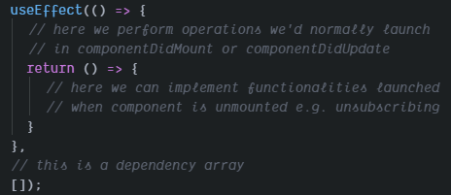
Basic hooks - useEffect
Hook introduced to perform side effects (fetching data, changing DOM manually, etc.) in function components
Functionalities of componentDidMount, componentDidUpdate, componentWillUnmount in one hook
Allows us to separate business contexts
First parameter – callback function, second parameter – dependency array

Slide 39
Basic hooks - useEffect
Dependency array defines the props which change will launch the hook
Empty dependency array – launched only on mount
useEffect always launches on mount
https://codesandbox.io/s/awesome-cloud-qdksh

Slide 40
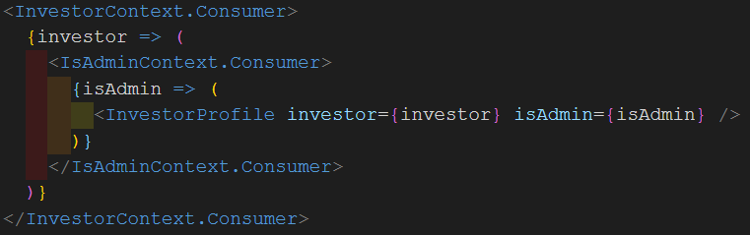

Basic hooks - useContext
Hook intended to faciliate the use of Context API
Allows us to share some state across many components in different trees without having to drill props
Previously we had to use context consumers to pass the data which wasn’t the most elegant solution
https://codesandbox.io/s/great-mayer-vcduw

Slide 41
Additional hooks – useMemo and useCallback
Both are used to achieve memoisation – useMemo returns a memoised value, useCallback a memoised function
The second argument to both hooks is a dependency array – if one of the dependencies changes, a new version is created
Both hooks provide a great synergy with PureComponent and memo (a wrapper that memoizes a function component), as they prevent functions and variables of complex type from receiving a new reference and thus rerendering
Example with useMemo and how it works with memo - https://codesandbox.io/s/hopeful-hooks-h3weh

Slide 42
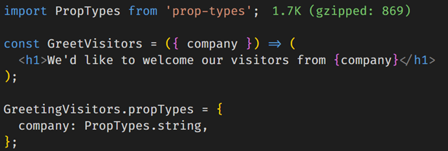
PropTypes
Declared as a property of a component
Range of validators which confirm that a prop’s type is as expected
Unlike TypeScript or Flow, doesn’t result in an error, instead a console warning is displayed
Previously a part of React, now maintained in a separate package
Apart from type, we can declare if a variable is required or optional

Slide 43
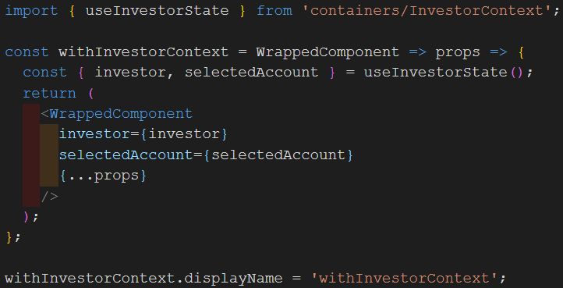
Higher Order Components (HOC)
Function which takes a component and returns it with some additional data or functionalities
HOCs can be easily composed to provide a component with data from different contexts
Can lead to HOC hell, so should be used carefully; hooks replaced lots of their use-cases

Slide 44
Routing

Slide 45
Routing in React
Routing allows us to declare subpages and which components they should display once accessed
React is not a framework, but a UI library – that’s why it’s necessary to use a third party library to introduce this functionality
Currently there are two popular routing libraries for React:
React Router
Reach Router
We’ll see examples from the first one, but both of them work in a similar way so migrating from one to another doesn’t take a lot of time

Slide 46
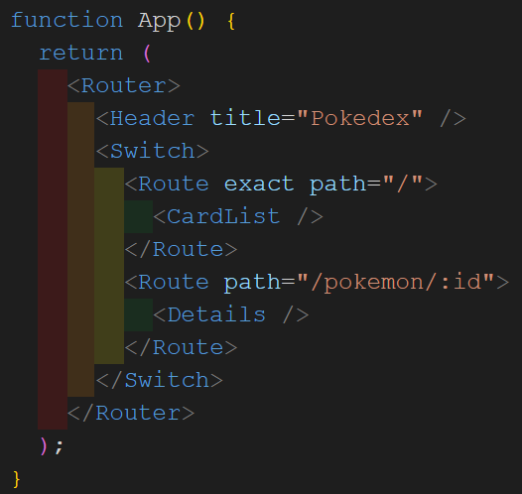
Example of a router component
Router – self-explanatory
Switch – renders the first child which matches the location
Route – parameters like path
Component – child of Route

Slide 47
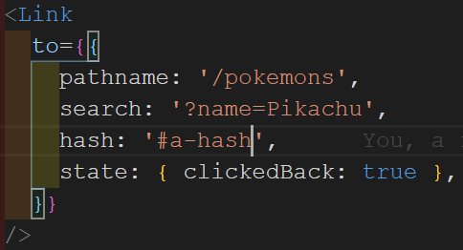
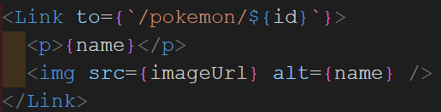
Links
Component used for redirecting to a route
Simplest case – passing a link via the to parameter
More advanced cases include passing search parametres, hashes to put in the url, state which will be persisted by the location object

Slide 48
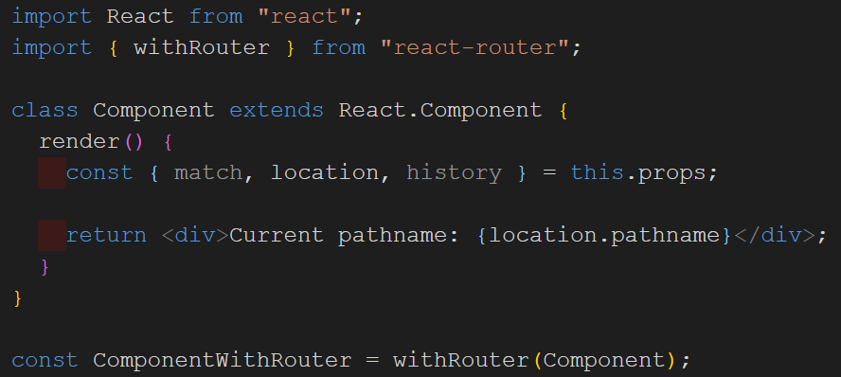
withRouter HOC
Wrapper which adds React-router parameter to the wrapped component’s props
Mainly used in class components nowadays, since functional components can use React-router’s hooks

Slide 49
React-router hooks
useParams – returns a params object which represents parameters declared in the route
useLocation – returns params that can be passed by the to method of <Link>
useHistory – returns history methods (e.g. push, go, goBack, goForward etc.), param length, location
will be replaced by useNavigate in the future
useRouteMatch – returns match data (path, isExact etc.), url and params

Slide 50
styled-components

Slide 51
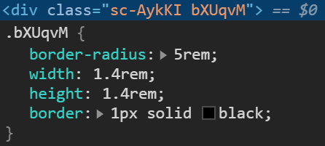
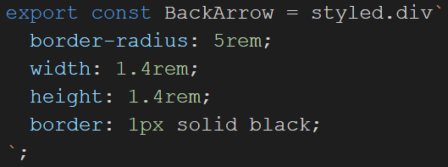
styled-components
A CSS-in-JS library, which allows us to use JS expressions inside of styles
Creating components instead of CSS classes
Unique names for classes – no duplication or misspelling
Easier to detect unused CSS – linting tool will signal when a styled component is unused

Slide 52
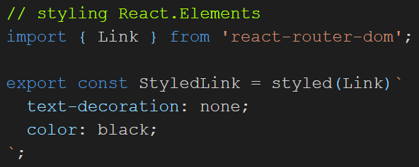

styled-components
React components can be styled as well – the only prerequisite is to put them inside parentheses, provided they attach the passed className prop to a DOM element
Extending styles works the same way – just put another styled component as an argument
Props can be passed to a component which allows a dynamic style creation

Slide 53
Live coding
We’re going to create a simple PokeDex app using the Pokemon Trading Card Game API - https://api.pokemontcg.io/v1/
Two views – list of all cards and details of one single card
React-router to handle the flow between pages
Styled-components to help us handle styles

Slide 54
Revision time
Create a simple app that uses router and styled-components
Try building it from the scratch
Examples:
Basic design of a shop
Music app which allows you to go between lists (you can create sets of data for each „list”)

Slide 55
ES6+ and React crash course
Day two

Slide 56
State management libraries

Slide 57
State management problems
Unidirectional data flow demands that we pass data all the way down the tree
This results in lots of unnecessary code in the top level components
It also makes it difficult to scale huge codebases and separate concerns
Possible errors might emerge e.g. during the refactoring process
With time, there might be lots of unused props passed down

Slide 58
Solution – one way data flow
Data is managed in some kind of store and manipulated by dispatching actions which update it
Instead of drilling props, we can call a function that accesses a chosen part of store
Examples of libraries:
Context API (created by Facebook, part of React)
Redux (co-created by Dan Abramov from the React Core team)
MobX

Slide 59
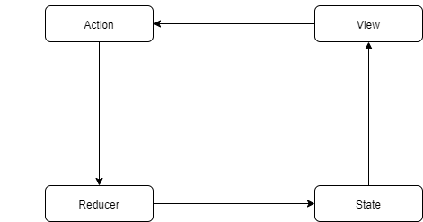
Redux
Created by Dan Abramov in 2014 for one of his conference talks
Redux - (Red)ucer + Fl(ux) - a variant of Flux pattern with a reducer function instead of a store
State (data) is kept in a store and manipulated by a reducer function
To manipulate data, we use actions, which pass the necessary data to reducer
Selectors are functions that select a chosen part of state

Slide 60
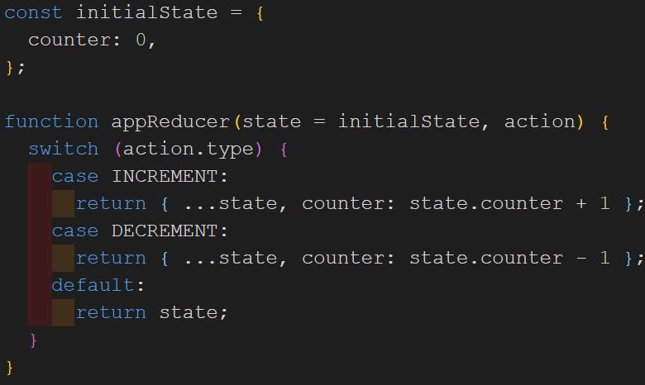
Reducer
Pure function which modifies the state in response to an action that was dispatched
The only part of application which should be responsible for state changes
Reducer always returns a new version of the state instead of mutating it (pure function)
Multiple reducers can be merged using the combineReducers method provided by Redux

Slide 61
React-redux
Library that offers React bindings for Redux:
<Provider /> – top level components which makes the Redux store available to the whole app
connect() – wrapper function which connects a component to the store
hooks:
useSelector – hook allowing to extract data from the store, needs to be provided with a pure selector function
useDispatch – hook returning a reference to the dispatch function, which allows us to launch actions without the need to use connect
useStore – hook returning a reference to the Redux store passed to <Provider />

Slide 62
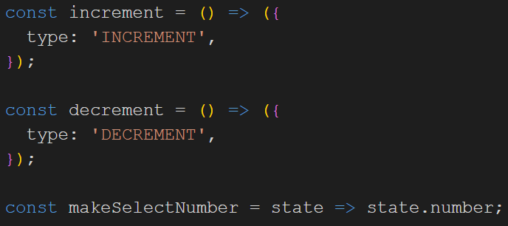
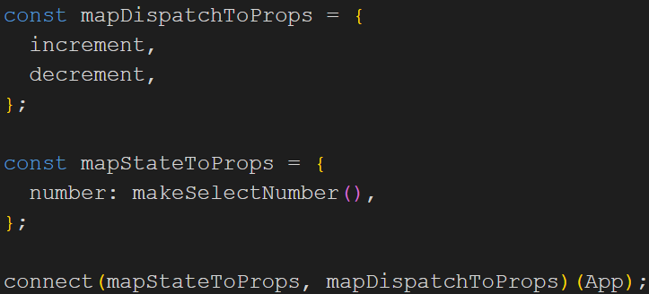
connect()
The first two arguments (both are optional) will be two functions:
function mapping a part of store to props (usually called mapStateToProps), containing a result of launching selector functions
function containing dispatch functions (actions), which will send some data to the reducer function
Two additional parameters are called mergeProps and options, but they’re used in more advanced cases, so we won’t focus on them in this course
The result of this function is then used to wrap a component

Slide 63
Rematch
A library made to reduce the amount of code that the Redux infrastructure creates
Models are structures that unite state, reducer, actions and asynchronous operations in one place
Typical model contains a state object, a reducers object, which contains actions and effects – functions responsible for async operations
Different models can easily refer to each other which allows a very down to earth and readable way to work on different sets of state at the same time

Slide 64
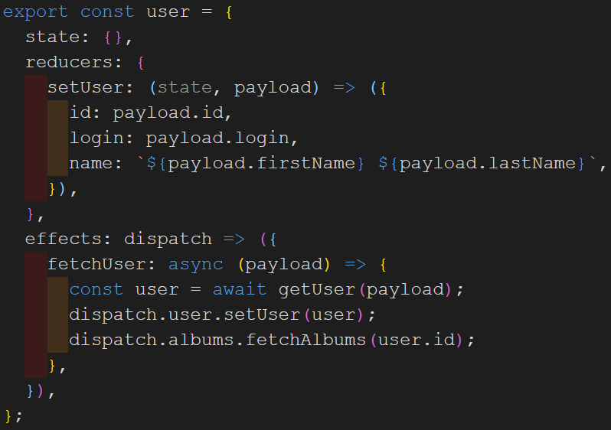
Rematch – model example
state declares some initial state
reducers contain methods that modify the store state
effects contain a method to download albums and save them in store
Different model can be easily accessed (dispatch.albums.setUser)

Slide 65
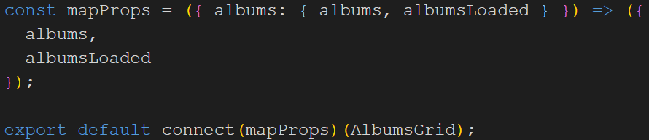

Rematch – example in a component
First, we have to connect the component using the connect method from react-redux
The setup is similar as in the traditional connect setup, but dispatching differs a bit - instead of importing actions from a file containing their declarations, we define which functions from a model interest us

Slide 66
Tests – Jest and Enzyme

Slide 67
Jest
Simple JS framework which can be used with lots of JS libraries, created by Facebook
Allows both assertion (expect(A).toEqual(B)) and snapshot (detect changes in a previously saved snapshot) tests
Built-in parallelization which allows quicker test processing
Adding the –coverage flag displays statistics of test coverage which also allows us to define a minimal level of coverage that has to be fulfilled
Any objects or functions outside of test’s scope can be mocked
beforeEach/afterEach allow us to define a repetition of behavior that would otherwise be written again
jest.fn and jest.spyOn are additional helpers that enable tracking the execution of specific functions

Slide 68


Jest - expect
Test needs to have a specific name convention (testName.test.js) to be launched
Usually, a test block begins by declaring a describe block – usually mentioning which component is tested
Then each test is written in a separate it or test block which should contain a brief description and assertions.
Launching tests will then show which tests failed or passed and why.
Tests can be disabled with an x prefix (e.g. xit)

Slide 69
Enzyme
Enzyme is a JS library made by airbnb, created specifically for React
Rich API which allows to test React’s functionalities
Three types of renders – shallow, mount and render
shallow – simplest render, used to create and test a component without testing its children
mount – full render with children, more expensive to execute
render – allows testing how children render without the overhead of lifecycle methods
Requires installing an adapter depending on which version of React is used
More advanced setup will require ejecting from create-react-app

Slide 70

Enzyme - example

Slide 71
Tools

Slide 72
Tools
Tools which we will discuss today are:
NPM – package manager for node
Eslint – linter tool which analyzes and reports patterns in JavaScript
Husky – tool for Git hooks which validate code before allowing to check in
create-react-app – quick setup for React projects with all necessary tools to lauch a basic app
Webpack – very powerful module bundler, capable of transforming, bundling, packaging code

Slide 73
npm
One of package managers for JavaScript projects
Default package manager for Node.js
Consists of:
a command line client (called npm as well)
an online database of public and private packages (npm registry)
Uses package.json to track the dependencies
File which contains more detailed data related to dependencies – package-lock.json
Source code for libraries stored in the node-modules category

Slide 74
Eslint
Tool for finding and fixing problems in code
Can be integrated with pipelines to ensure the correctness of code pushed to the repository
Great flexibility allowing to maximally customize the rules according to our needs
Lots of presets which already cover most of rules
Ensures one style of writing code in a codebase

Slide 75
Husky
Commands ran before or after certain points of git’s execution
Mostly used with tools like eslint or jest to avoid commiting code that’s against the styling rules and passes tests
Combine with a tool like lint-staged to automatically apply fixes and add them to a commit
May target git functions like e.g.:
commit – before a commit log message is obtained/after a commit is made
merge-commit – for cases like merging with another branch like develop
push – can prevent push from taking place is rules aren’t met

Slide 76
Webpack
Tool for bundling modules and running tasks
Enables functionalities like:
Code splitting – splits code into small modules which are loaded when needed instead of one huge file (lazy loading)
Converting files of various extensions (CSS preprocessors, React files etc.) to the ones that browser can interpret
Compressing files to decrease the final bundle size (minification)
Applying babel which allows developers to use modern JavaScript functionalities while remaining compatible with older browsers
Caching files to save bandwith
Treeshaking – elliminating dead-code
Creating different rules for development and production
And many, many, many more…

Slide 77
create-react-app
Tool created by Facebook to faciliate the process of creating apps
Arrives with a basic config of:
Webpack
Babel
Eslint
TypeScript
PWA
development server
tests config
Advanced users can opt to eject to a custom setup which allows more configuration freedom

Slide 78
Thanks for your attention!

